Slide 2
South America is home to a diverse range of lizard species, each with unique characteristics and adaptations to the various habitats found across the continent. This comprehensive research explores the fascinating world of South American lizards, highlighting the unique characteristics, habitats, and ecological significance of three remarkable species.

Slide 3
South America is home to a diverse array of lizard species, ranging from small geckos to large iguanas. This continent is home to various lizard families, each with its unique characteristics and ecological roles.

Slide 4
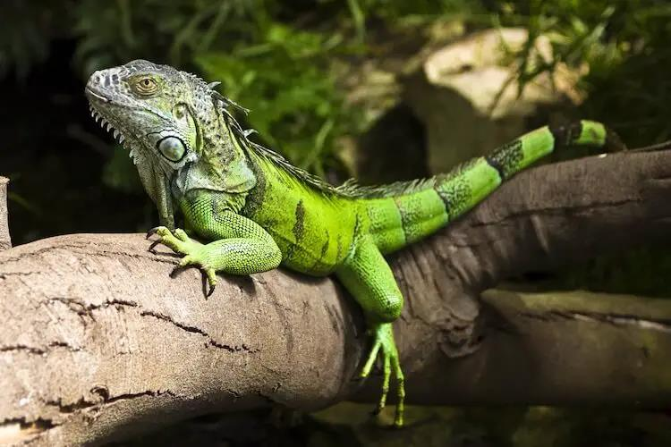

Slide 5
The Caiman Lizard (Dracaena guianensis) is a captivating reptile native to the tropical regions of South America. The Tepui Lizard (Pristidactylus urichi) is a captivating and unique reptile inhabiting the Tepui plateaus of South America.

Slide 6
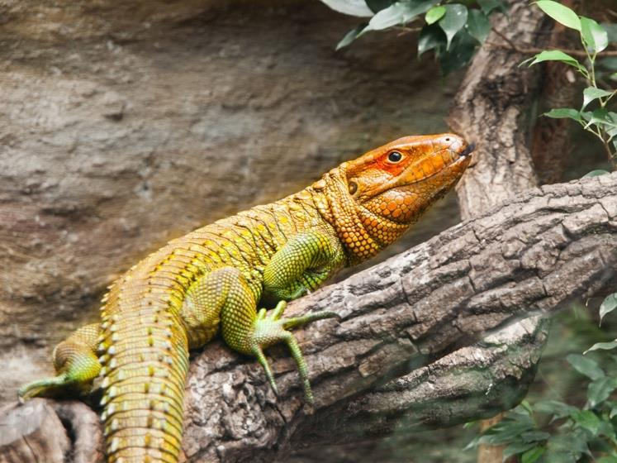

Slide 7
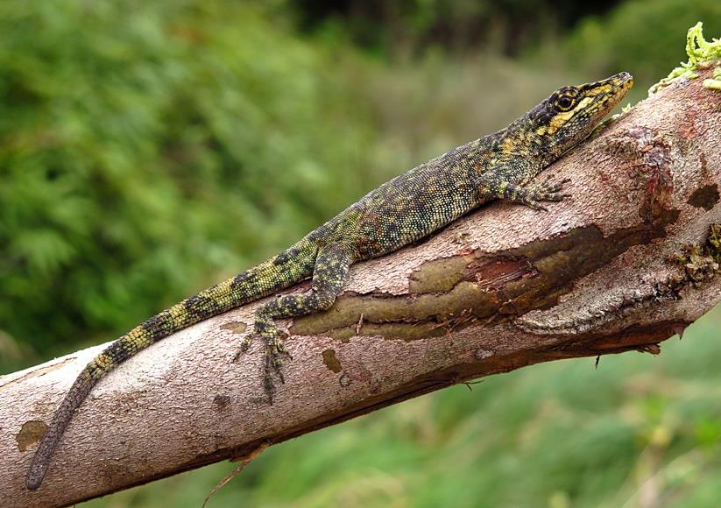

Slide 8
South America is home to an impressive diversity of lizards, including the Green Iguana, Caiman Lizard, and Tepui Lizard. These captivating creatures play crucial ecological roles in their respective habitats, contributing to the overall balance and health of their ecosystems. However, they face various threats, including habitat loss, illegal pet trade, pollution, and climate change, which impact their survival and wellbeing. Conservation efforts are essential to safeguarding these lizards and the biodiversity they contribute to South American ecosystems.

Slide 9
South American lizards are facing numerous threats, such as habitat loss, climate change, and illegal trade, which necessitate urgent conservation efforts.

